Slide 1
Spatial Filtering
Dr. Sk. Md. Masudul Ahsan
Dept. of CSE, KUET

Slide 2
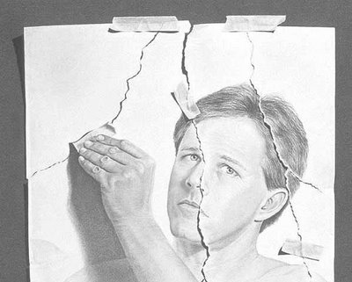
General Image Operations
Three type of image operations
Point operations
Geometric operations
Spatial operations

Slide 3
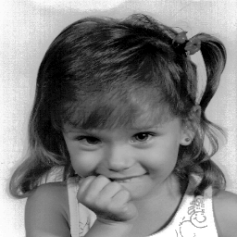
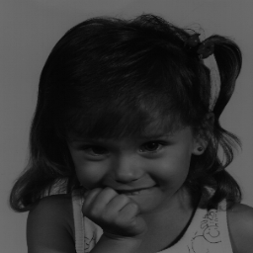
Point Operations

Slide 4
Point Operations
Operation depends on Pixel's value.
Context free (memory-less).
Operation can be performed on the Histogram.
Example:

Slide 5
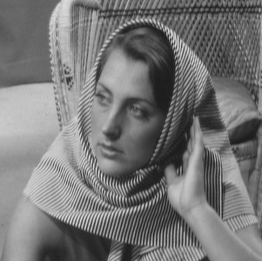
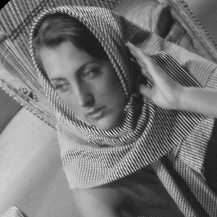
Geometric Operations

Slide 6
Geometric Operations
Operation depend on pixel's coordinates.
Context free.
Independent of pixels value.
Example:

Slide 7
Spatial Operations

Slide 8
Spatial Operations
Operation depends on Pixel's value and coordinates.
Context dependant.
Spatial v.s. Frequency domain.
Example:

Slide 9
Image filtering
Image filtering: compute function of local neighborhood at each position
Really important!
Enhance images
Denoise, resize, increase contrast, etc.
Extract information from images
Texture, edges, distinctive points, etc.
Detect patterns
Template matching

Slide 10
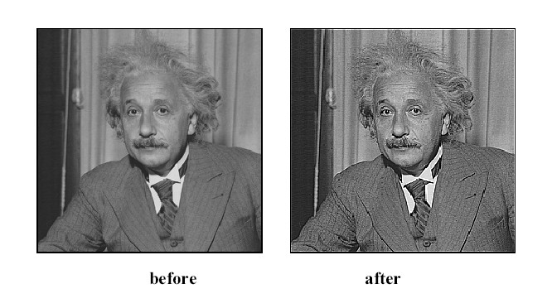

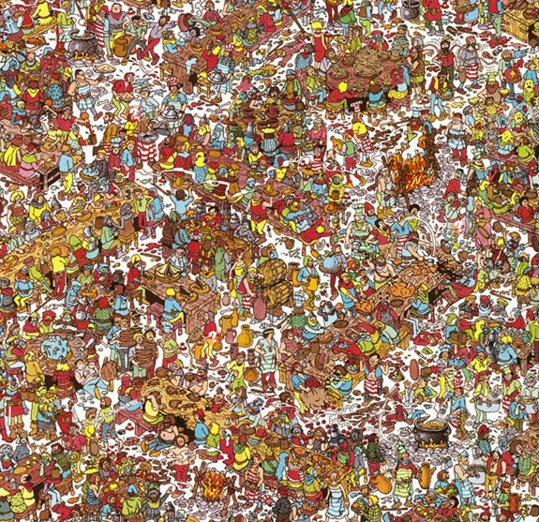
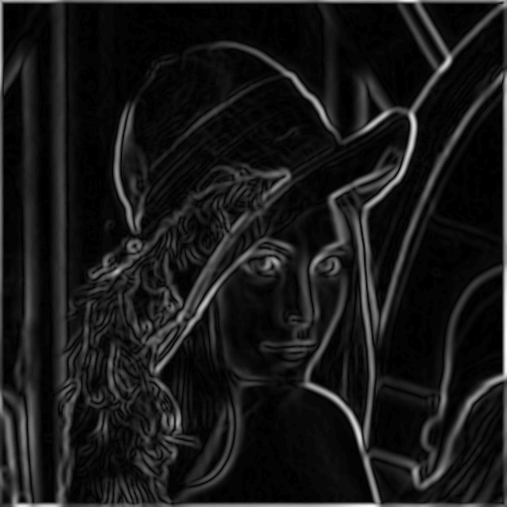
Today: Image Filters
Smooth/Sharpen Images... Find edges... Find waldo…

Slide 11
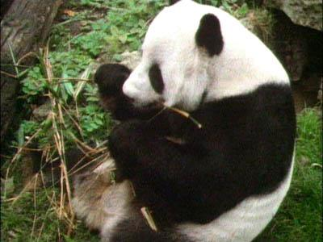
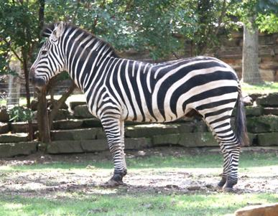
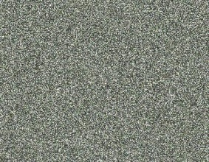
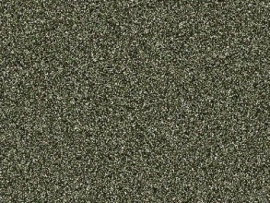
Image neighborhoods
Q: What happens if we reshuffle all pixels within the images?
A: Its histogram won’t change. Point-wise processing unaffected.
Need to measure properties relative to small neighborhoods of pixels

Slide 12
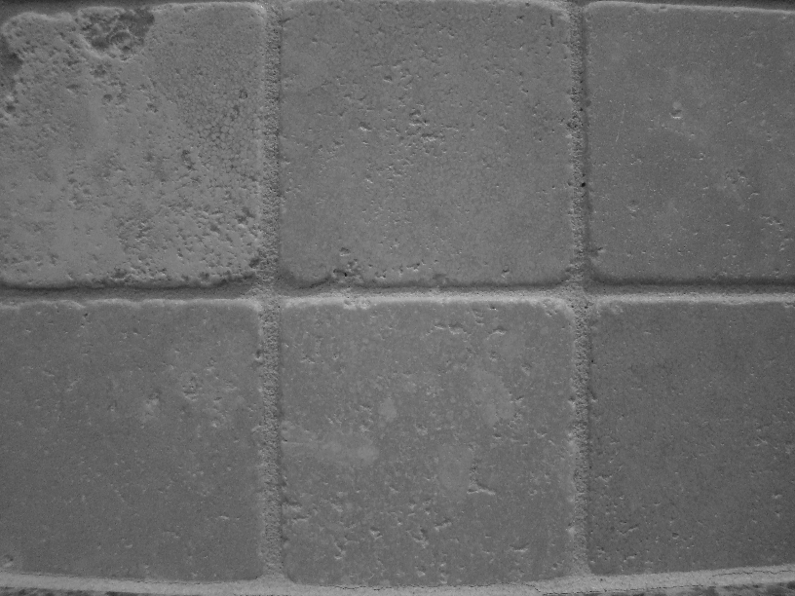
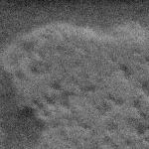
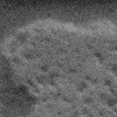

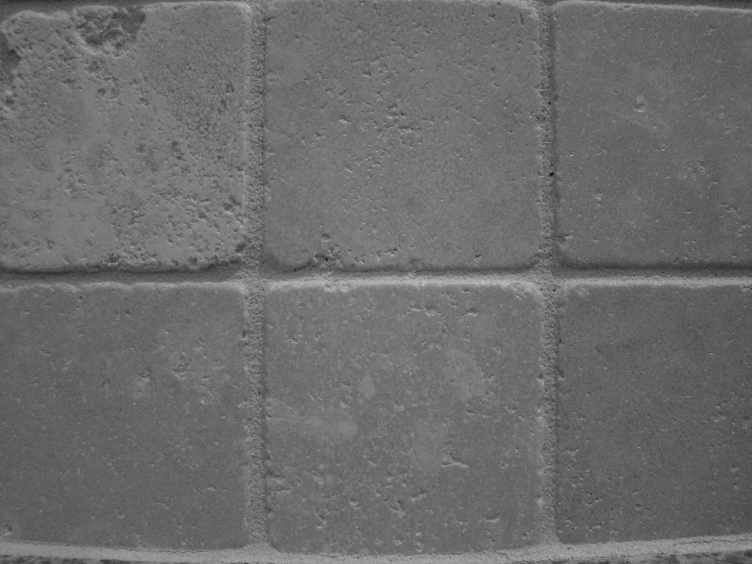
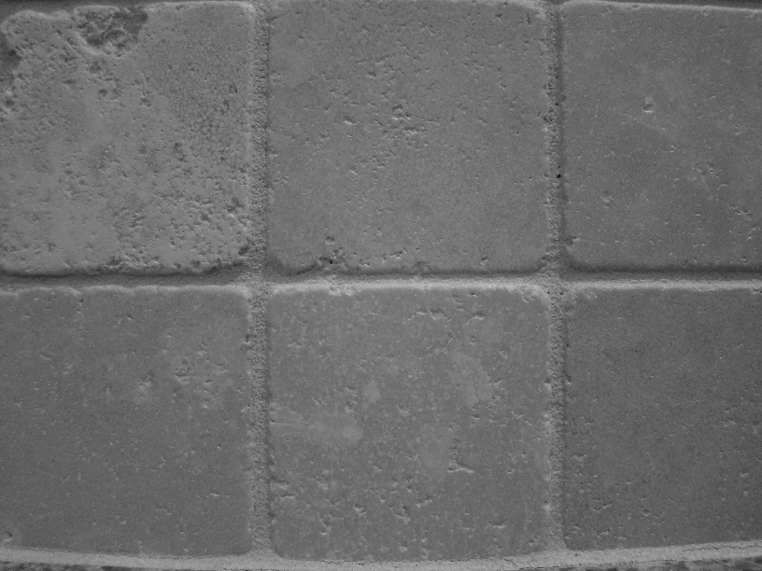


Motivation: noise reduction
We can measure noise in multiple images of the same static scene.
How could we reduce the noise, i.e., give an estimate of the true intensities?

Slide 13
Motivation: noise reduction
How could we reduce the noise, i.e., give an estimate of the true intensities?
What if there’s only one image?

Slide 14
First attempt at a solution
Let’s replace each pixel with an average of all the values in its neighborhood
Assumptions:
Expect pixels to be like their neighbors
Expect noise processes to be independent from pixel to pixel

Slide 15
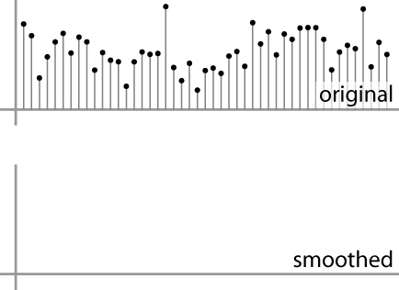
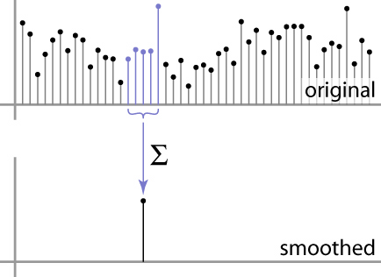
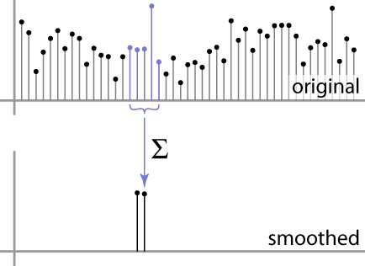
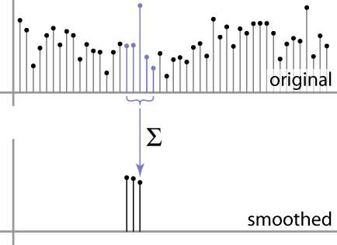
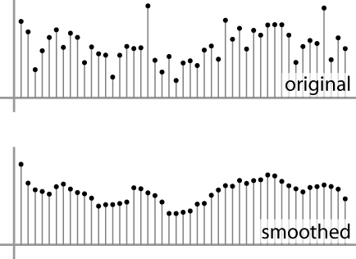
First attempt at a solution
Let’s replace each pixel with an average of all the values in its neighborhood
Moving average in 1D:
Source: S. Marschner

Slide 16
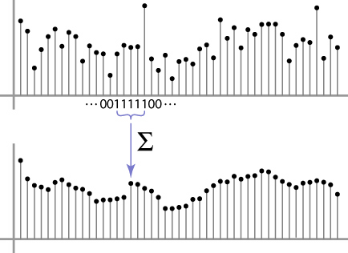
Weighted Moving Average
Can add weights to our moving average
Weights [1, 1, 1, 1, 1] / 5
Source: S. Marschner

Slide 17

Weighted Moving Average
Non-uniform weights [1, 4, 6, 4, 1] / 16
Source: S. Marschner

Slide 18
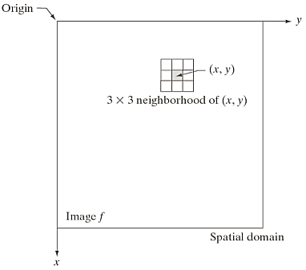
Filtering
Filter term in “Digital image processing” is referred to the subimage
Others terms - mask, kernel, template, or window
The value in a filter subimage are referred as coefficients, rather than pixels.
The word “filtering” has been borrowed from the frequency domain.
Spatial filtering term is the filtering operations that are performed directly on the pixels of an image

Slide 19
Mechanics of spatial filtering
Need to define:
(1) a neighborhood (or mask) - Typically, rectangular and its size is much smaller than that of f(x,y)
e.g. - 3x3 or 5x5
(2) an operation
e.g. - weighted sum of input pixels

Slide 20
Mechanics of spatial filtering
The process consists simply of moving the center of the filter mask from point to point in an image.
At each point (x,y) the response of the filter at that point is calculated using a predefined relationship
mask
weights:
output image

Slide 21
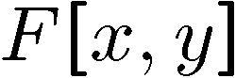
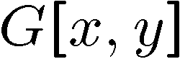
Moving Average In 2D
0 | 0 | 0 | 0 | 0 | 0 | 0 | 0 | 0 | 0
0 | 0 | 0 | 0 | 0 | 0 | 0 | 0 | 0 | 0
0 | 0 | 0 | 90 | 90 | 90 | 90 | 90 | 0 | 0
0 | 0 | 0 | 90 | 90 | 90 | 90 | 90 | 0 | 0
0 | 0 | 0 | 90 | 90 | 90 | 90 | 90 | 0 | 0
0 | 0 | 0 | 90 | 0 | 90 | 90 | 90 | 0 | 0
0 | 0 | 0 | 90 | 90 | 90 | 90 | 90 | 0 | 0
0 | 0 | 0 | 0 | 0 | 0 | 0 | 0 | 0 | 0
0 | 0 | 90 | 0 | 0 | 0 | 0 | 0 | 0 | 0
0 | 0 | 0 | 0 | 0 | 0 | 0 | 0 | 0 | 0
 | 0
0 | 0 | 0 | 0 | 0 | 0 | 0 | 0 | 0 | 0
0 | 0 | 0 | 0 | 0 | 0 | 0 | 0 | 0 | 0
0 | 0 | 0 | 90 | 90 | 90 | 90 | 90 | 0 | 0
0 | 0 | 0 | 90 | 90 | 90 | 90 | 90 | 0 | 0
0 | 0 | 0 | 90 | 90 | 90 | 90 | 90 | 0 | 0
0 | 0 | 0 | 90 | 0 | 90 | 90 | 90 | 0 | 0
0 | 0 | 0 | 90 | 90 | 90 | 90 | 90 | 0 | 0
0 | 0 | 0 | 0 | 0 | 0 | 0 | 0 | 0 | 0
0 | 0 | 90 | 0 | 0 | 0 | 0 | 0 | 0 | 0
0 | 0 | 0 | 0 | 0 | 0 | 0 | 0 | 0 | 0
Source: S. Seitz
Notes:
ones, divide by 9

Slide 22
Moving Average In 2D
0 | 0 | 0 | 0 | 0 | 0 | 0 | 0 | 0 | 0
0 | 0 | 0 | 0 | 0 | 0 | 0 | 0 | 0 | 0
0 | 0 | 0 | 90 | 90 | 90 | 90 | 90 | 0 | 0
0 | 0 | 0 | 90 | 90 | 90 | 90 | 90 | 0 | 0
0 | 0 | 0 | 90 | 90 | 90 | 90 | 90 | 0 | 0
0 | 0 | 0 | 90 | 0 | 90 | 90 | 90 | 0 | 0
0 | 0 | 0 | 90 | 90 | 90 | 90 | 90 | 0 | 0
0 | 0 | 0 | 0 | 0 | 0 | 0 | 0 | 0 | 0
0 | 0 | 90 | 0 | 0 | 0 | 0 | 0 | 0 | 0
0 | 0 | 0 | 0 | 0 | 0 | 0 | 0 | 0 | 0
 | 0 | 10
0 | 0 | 0 | 0 | 0 | 0 | 0 | 0 | 0 | 0
0 | 0 | 0 | 0 | 0 | 0 | 0 | 0 | 0 | 0
0 | 0 | 0 | 90 | 90 | 90 | 90 | 90 | 0 | 0
0 | 0 | 0 | 90 | 90 | 90 | 90 | 90 | 0 | 0
0 | 0 | 0 | 90 | 90 | 90 | 90 | 90 | 0 | 0
0 | 0 | 0 | 90 | 0 | 90 | 90 | 90 | 0 | 0
0 | 0 | 0 | 90 | 90 | 90 | 90 | 90 | 0 | 0
0 | 0 | 0 | 0 | 0 | 0 | 0 | 0 | 0 | 0
0 | 0 | 90 | 0 | 0 | 0 | 0 | 0 | 0 | 0
0 | 0 | 0 | 0 | 0 | 0 | 0 | 0 | 0 | 0
Source: S. Seitz
Notes:
ones, divide by 9

Slide 23
Moving Average In 2D
0 | 0 | 0 | 0 | 0 | 0 | 0 | 0 | 0 | 0
0 | 0 | 0 | 0 | 0 | 0 | 0 | 0 | 0 | 0
0 | 0 | 0 | 90 | 90 | 90 | 90 | 90 | 0 | 0
0 | 0 | 0 | 90 | 90 | 90 | 90 | 90 | 0 | 0
0 | 0 | 0 | 90 | 90 | 90 | 90 | 90 | 0 | 0
0 | 0 | 0 | 90 | 0 | 90 | 90 | 90 | 0 | 0
0 | 0 | 0 | 90 | 90 | 90 | 90 | 90 | 0 | 0
0 | 0 | 0 | 0 | 0 | 0 | 0 | 0 | 0 | 0
0 | 0 | 90 | 0 | 0 | 0 | 0 | 0 | 0 | 0
0 | 0 | 0 | 0 | 0 | 0 | 0 | 0 | 0 | 0
 | 0 | 10 | 20
0 | 0 | 0 | 0 | 0 | 0 | 0 | 0 | 0 | 0
0 | 0 | 0 | 0 | 0 | 0 | 0 | 0 | 0 | 0
0 | 0 | 0 | 90 | 90 | 90 | 90 | 90 | 0 | 0
0 | 0 | 0 | 90 | 90 | 90 | 90 | 90 | 0 | 0
0 | 0 | 0 | 90 | 90 | 90 | 90 | 90 | 0 | 0
0 | 0 | 0 | 90 | 0 | 90 | 90 | 90 | 0 | 0
0 | 0 | 0 | 90 | 90 | 90 | 90 | 90 | 0 | 0
0 | 0 | 0 | 0 | 0 | 0 | 0 | 0 | 0 | 0
0 | 0 | 90 | 0 | 0 | 0 | 0 | 0 | 0 | 0
0 | 0 | 0 | 0 | 0 | 0 | 0 | 0 | 0 | 0
Source: S. Seitz
Notes:
ones, divide by 9

Slide 24
Moving Average In 2D
0 | 0 | 0 | 0 | 0 | 0 | 0 | 0 | 0 | 0
0 | 0 | 0 | 0 | 0 | 0 | 0 | 0 | 0 | 0
0 | 0 | 0 | 90 | 90 | 90 | 90 | 90 | 0 | 0
0 | 0 | 0 | 90 | 90 | 90 | 90 | 90 | 0 | 0
0 | 0 | 0 | 90 | 90 | 90 | 90 | 90 | 0 | 0
0 | 0 | 0 | 90 | 0 | 90 | 90 | 90 | 0 | 0
0 | 0 | 0 | 90 | 90 | 90 | 90 | 90 | 0 | 0
0 | 0 | 0 | 0 | 0 | 0 | 0 | 0 | 0 | 0
0 | 0 | 90 | 0 | 0 | 0 | 0 | 0 | 0 | 0
0 | 0 | 0 | 0 | 0 | 0 | 0 | 0 | 0 | 0
 | 0 | 10 | 20 | 30
0 | 0 | 0 | 0 | 0 | 0 | 0 | 0 | 0 | 0
0 | 0 | 0 | 0 | 0 | 0 | 0 | 0 | 0 | 0
0 | 0 | 0 | 90 | 90 | 90 | 90 | 90 | 0 | 0
0 | 0 | 0 | 90 | 90 | 90 | 90 | 90 | 0 | 0
0 | 0 | 0 | 90 | 90 | 90 | 90 | 90 | 0 | 0
0 | 0 | 0 | 90 | 0 | 90 | 90 | 90 | 0 | 0
0 | 0 | 0 | 90 | 90 | 90 | 90 | 90 | 0 | 0
0 | 0 | 0 | 0 | 0 | 0 | 0 | 0 | 0 | 0
0 | 0 | 90 | 0 | 0 | 0 | 0 | 0 | 0 | 0
0 | 0 | 0 | 0 | 0 | 0 | 0 | 0 | 0 | 0
Source: S. Seitz
Notes:
ones, divide by 9

Slide 25
Moving Average In 2D
0 | 0 | 0 | 0 | 0 | 0 | 0 | 0 | 0 | 0
0 | 0 | 0 | 0 | 0 | 0 | 0 | 0 | 0 | 0
0 | 0 | 0 | 90 | 90 | 90 | 90 | 90 | 0 | 0
0 | 0 | 0 | 90 | 90 | 90 | 90 | 90 | 0 | 0
0 | 0 | 0 | 90 | 90 | 90 | 90 | 90 | 0 | 0
0 | 0 | 0 | 90 | 0 | 90 | 90 | 90 | 0 | 0
0 | 0 | 0 | 90 | 90 | 90 | 90 | 90 | 0 | 0
0 | 0 | 0 | 0 | 0 | 0 | 0 | 0 | 0 | 0
0 | 0 | 90 | 0 | 0 | 0 | 0 | 0 | 0 | 0
0 | 0 | 0 | 0 | 0 | 0 | 0 | 0 | 0 | 0
 | 0 | 10 | 20 | 30 | 30
Source: S. Seitz
Notes:
ones, divide by 9

Slide 26
Moving Average In 2D
0 | 0 | 0 | 0 | 0 | 0 | 0 | 0 | 0 | 0
0 | 0 | 0 | 0 | 0 | 0 | 0 | 0 | 0 | 0
0 | 0 | 0 | 90 | 90 | 90 | 90 | 90 | 0 | 0
0 | 0 | 0 | 90 | 90 | 90 | 90 | 90 | 0 | 0
0 | 0 | 0 | 90 | 90 | 90 | 90 | 90 | 0 | 0
0 | 0 | 0 | 90 | 0 | 90 | 90 | 90 | 0 | 0
0 | 0 | 0 | 90 | 90 | 90 | 90 | 90 | 0 | 0
0 | 0 | 0 | 0 | 0 | 0 | 0 | 0 | 0 | 0
0 | 0 | 90 | 0 | 0 | 0 | 0 | 0 | 0 | 0
0 | 0 | 0 | 0 | 0 | 0 | 0 | 0 | 0 | 0
 | 0 | 10 | 20 | 30 | 30 | 30 | 20 | 10
 | 0 | 20 | 40 | 60 | 60 | 60 | 40 | 20
 | 0 | 30 | 60 | 90 | 90 | 90 | 60 | 30
 | 0 | 30 | 50 | 80 | 80 | 90 | 60 | 30
 | 0 | 30 | 50 | 80 | 80 | 90 | 60 | 30
 | 0 | 20 | 30 | 50 | 50 | 60 | 40 | 20
 | 10 | 20 | 30 | 30 | 30 | 30 | 20 | 10
 | 10 | 10 | 10 | 0 | 0 | 0 | 0 | 0
Source: S. Seitz
Notes:
ones, divide by 9

Slide 27
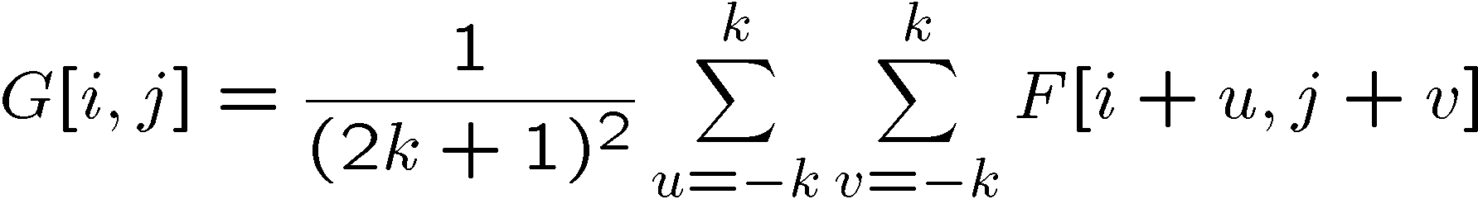
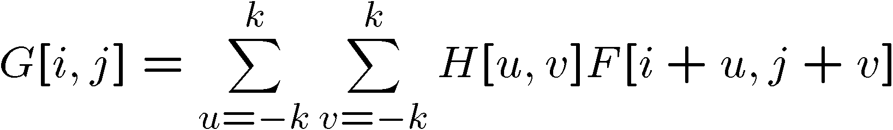
Correlation filtering
Say the averaging window size is 2k+1 x 2k+1:
Attribute uniform weight to each pixel
Loop over all pixels in neighborhood around image pixel F[i,j]
Now generalize to allow different weights depending on neighboring pixel’s relative position:
Non-uniform weights

Slide 28
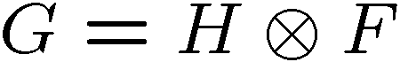
Correlation filtering
This is called cross-correlation, denoted
Filtering an image: replace each pixel with a linear combination of its neighbors.
The filter “kernel” or “mask” H[u,v] is the prescription for the weights in the linear combination.

Slide 29
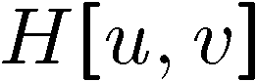

Averaging filter
What values belong in the kernel H for the moving average example?
0 | 0 | 0 | 0 | 0 | 0 | 0 | 0 | 0 | 0
0 | 0 | 0 | 0 | 0 | 0 | 0 | 0 | 0 | 0
0 | 0 | 0 | 90 | 90 | 90 | 90 | 90 | 0 | 0
0 | 0 | 0 | 90 | 90 | 90 | 90 | 90 | 0 | 0
0 | 0 | 0 | 90 | 90 | 90 | 90 | 90 | 0 | 0
0 | 0 | 0 | 90 | 0 | 90 | 90 | 90 | 0 | 0
0 | 0 | 0 | 90 | 90 | 90 | 90 | 90 | 0 | 0
0 | 0 | 0 | 0 | 0 | 0 | 0 | 0 | 0 | 0
0 | 0 | 90 | 0 | 0 | 0 | 0 | 0 | 0 | 0
0 | 0 | 0 | 0 | 0 | 0 | 0 | 0 | 0 | 0
 | 0 | 10 | 20 | 30 | 30
1
1
1
1
?
1
1
1
1
1
“box filter”

Slide 30
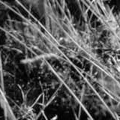
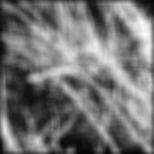
Smoothing by averaging
depicts box filter:
white = high value, black = low value
original
filtered

Slide 31
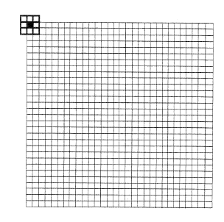
Mechanics of spatial filtering
Handling Pixels Close to Boundaries
pad with zeroes
0 0 0 ……………………….0
or
0 0 0 ……………………….0

Slide 32
Boundary issues
What is the size of the output?
g
g
g
g
f
f
f
g
g
g
g
g
g
g
g
Source: S. Lazebnik

Slide 33
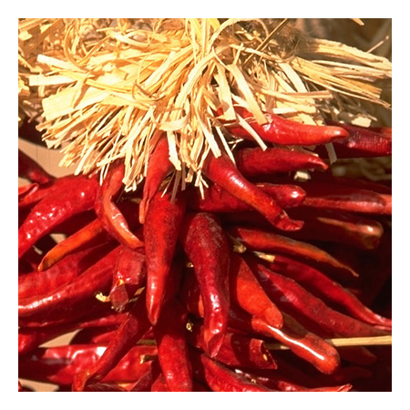
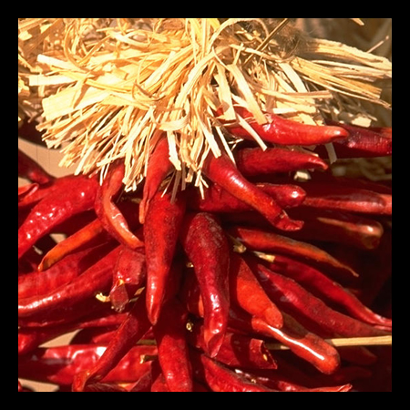

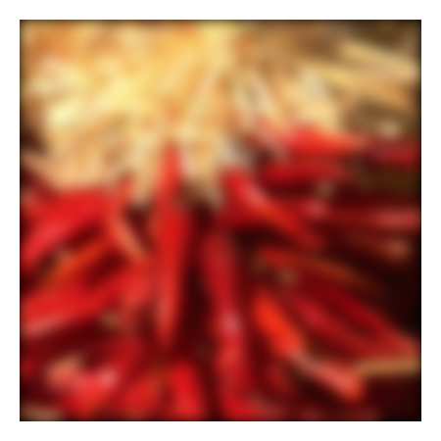
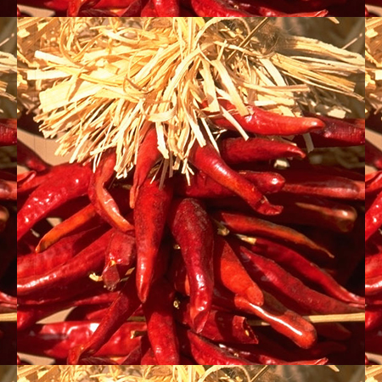

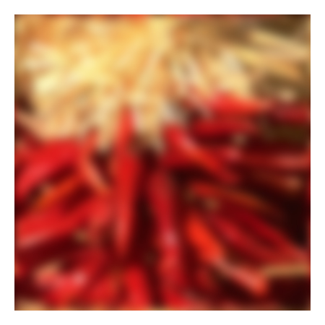
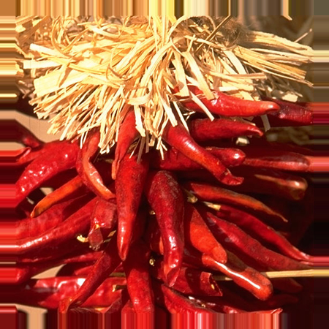





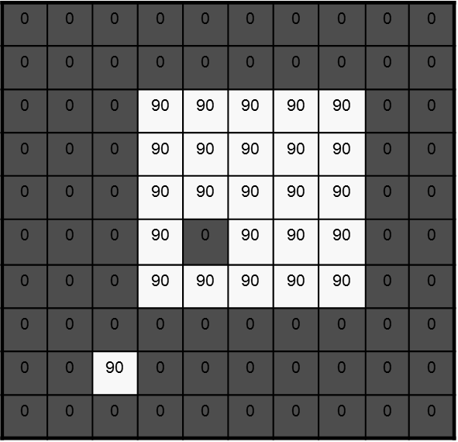
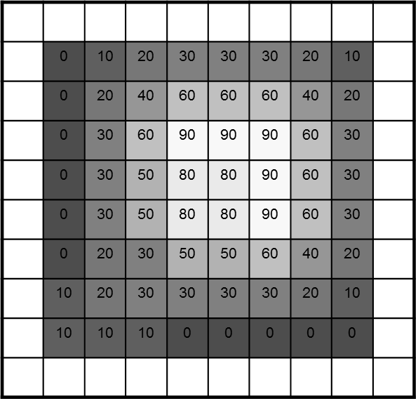
Boundary issues
What about near the edge?
the filter window falls off the edge of the image
need to extrapolate
methods:
clip filter (black)
wrap around
copy edge
reflect across edge
Wrap
Copy
Reflect
Clip
Source: S. Marschner

Slide 34
Linear vs Non-linear filter
If the computations performed on the pixels of the neighborhoods are linear, the operation is called linear spatial filtering;
Linear - when the output is a weighted sum of the input pixels.
otherwise it is called nonlinear spatial filtering.
e.g.

Slide 35
Linear spatial filtering
Pixels of image
The result is the sum of products of the mask coefficients with the corresponding pixels directly under the mask
f(x-1,y-1)
w(-1,-1)
f(x-1,y)
w(-1,0)
f(x-1,y+1)
w(-1,1)
f(x,y-1)
w(0,-1)
f(x,y)
w(0,0)
f(x,y+1)
w(0,1)
Mask coefficients
w(-1,-1)
w(-1,0)
w(-1,1)
f(x+1,y-1)
w(1,-1)
f(x+1,y)
w(1,0)
f(x+1,y+1)
w(1,1)
w(0,-1)
w(0,0)
w(0,1)
w(1,-1)
w(1,0)
w(1,1)

Slide 36
Linear spatial filtering
The coefficient w(0,0) coincides with image value f(x,y), indicating that the mask is centered at (x,y)
For a mask of size mxn, we assume that
m=2a+1 and n=2b+1, where a and b are non-negative integer.
Then m and n are odd.
In general, linear filtering of an image f of size MxN with a filter mask of size mxn is given by the expression:

Slide 37
Linear Spatial Filtering Methods
Main linear spatial filtering methods:
Correlation
Convolution

Slide 38
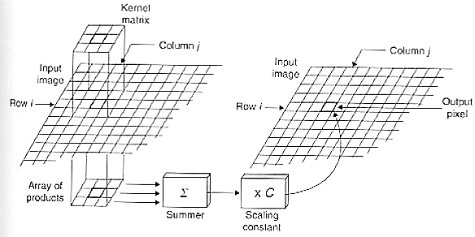
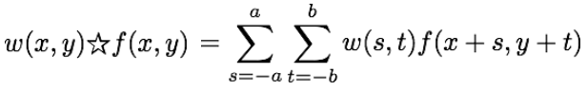
Correlation
w(i,j)
g(i,j)
Output
Image
f(i,j)

Slide 39
Convolution
Flip the filter in both dimensions (bottom to top, right to left)
Then apply cross-correlation
★
h
h
f
Notation for convolution operator
Note: if w(i, j) is symmetric, that is w(i, j) = w(-i,-j), then convolution is equivalent to correlation!

Slide 40
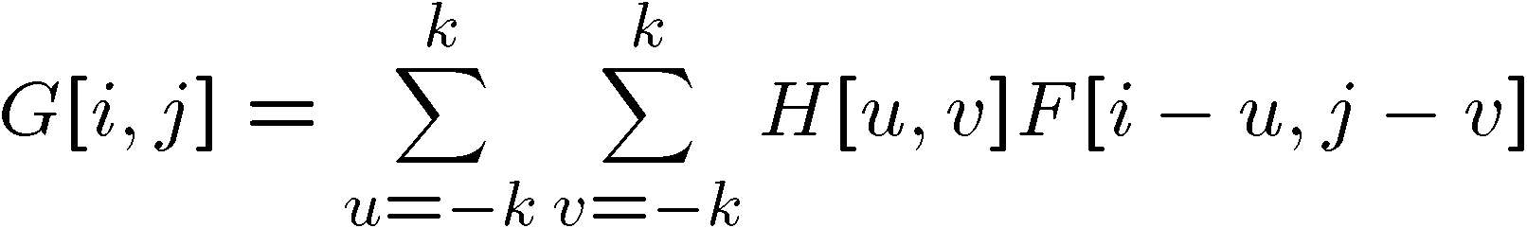
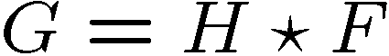
Convolution vs. correlation
Convolution
Cross-correlation
For a Gaussian or box filter, how will the outputs differ?
If the input is an impulse signal, how will the outputs differ?

Slide 41
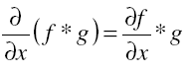
Properties of convolution
Linear & shift invariant
Commutative:
f * g = g * f
Associative
(f * g) * h = f * (g * h)
Identity:
unit impulse e = […, 0, 0, 1, 0, 0, …]. f * e = f
Differentiation:

Slide 42
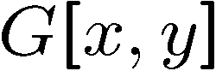
Filtering an impulse signal
What is the result of filtering the impulse signal (image) F with the arbitrary kernel H?
0 | 0 | 0 | 0 | 0 | 0 | 0
0 | 0 | 0 | 0 | 0 | 0 | 0
0 | 0 | 0 | 0 | 0 | 0 | 0
0 | 0 | 0 | 1 | 0 | 0 | 0
0 | 0 | 0 | 0 | 0 | 0 | 0
0 | 0 | 0 | 0 | 0 | 0 | 0
0 | 0 | 0 | 0 | 0 | 0 | 0
a | b | c
d | e | f
g | h | i
?

Slide 43
Filtering an impulse signal
What is the result of filtering the impulse signal (image) F with the arbitrary kernel H?
0 | 0 | 0 | 0 | 0 | 0 | 0
0 | 0 | 0 | 0 | 0 | 0 | 0
0 | 0 | 0 | 0 | 0 | 0 | 0
0 | 0 | 0 | 1 | 0 | 0 | 0
0 | 0 | 0 | 0 | 0 | 0 | 0
0 | 0 | 0 | 0 | 0 | 0 | 0
0 | 0 | 0 | 0 | 0 | 0 | 0
0 | 0 | 0 | 0 | 0 | 0 | 0
0 | 0 | 0 | 0 | 0 | 0 | 0
0 | 0 | 0 | 0 | 0 | 0 | 0
0 | 0 | 0 | 1 | 0 | 0 | 0
0 | 0 | 0 | 0 | 0 | 0 | 0
0 | 0 | 0 | 0 | 0 | 0 | 0
0 | 0 | 0 | 0 | 0 | 0 | 0
a | b | c
d | e | f
g | h | i
a | b | c
d | e | f
g | h | i

Slide 44
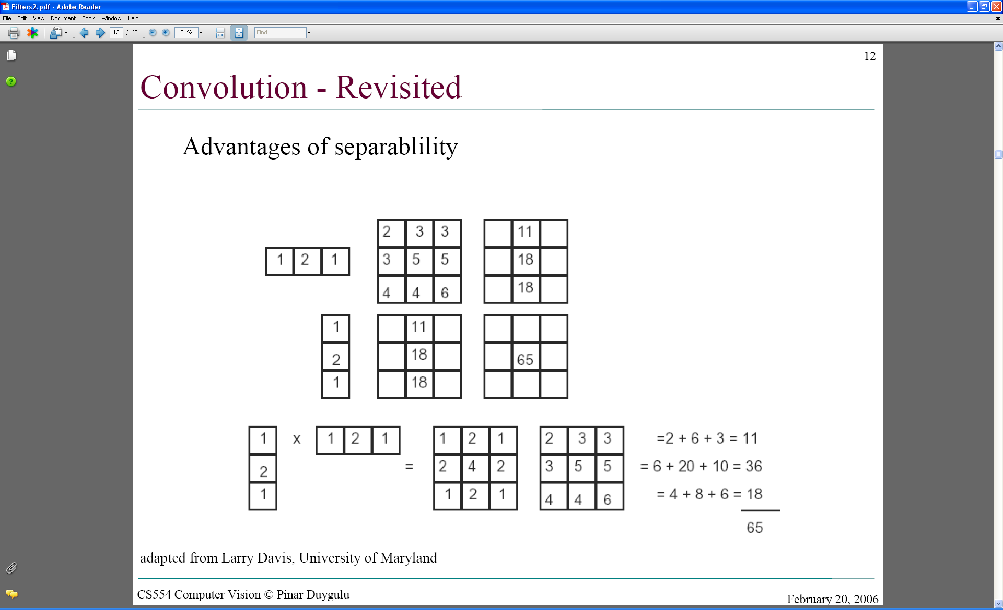
Separability
In some cases, filter is separable, and we can factor into two steps: e.g.,
Convolve all rows
Convolve all columns
h
g
f
f * (g * h) = (f * g) * h

Slide 45
Separability
What is the computational complexity advantage for a separable filterin terms of number of operations per output pixel?
Filtering an M-by-N image with a P-by-Q filter kernel requires roughly MNPQ multiplies and adds (assuming we aren't using an implementation based on the FFT).
If the kernel is separable, you can filter in two steps.
The first step requires about MNP multiplies and adds.
The second requires about MNQ multiplies and adds
for a total of MN(P + Q).
The computational advantage of separable convolution versus nonseparable convolution is therefore: PQ/(P+Q)
For a 9-by-9 filter kernel, that's a theoretical speed-up of 4.5.

Slide 46
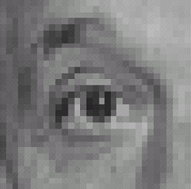
Practice with linear filters
0
0
0
?
0
1
0
Original
0
0
0
Filtered
(no change)
0
0
0
0
0
1
0
0
0
?
Shifted left
by 1 pixel with correlation
Source: D. Lowe

Slide 47
Shift invariant linear system
Shift invariant:
Operator behaves the same everywhere, i.e. the value of the output depends on the pattern in the image neighborhood, not the position of the neighborhood.
Linear:
Superposition: h * (f1 + f2) = (h * f1) + (h * f2)
Scaling: h * (k f) = k (h * f)

Slide 48
Correlation (cont’d)
Often used in applications where we need to measure the similarity between images or parts of images
(e.g., template matching).

Slide 49
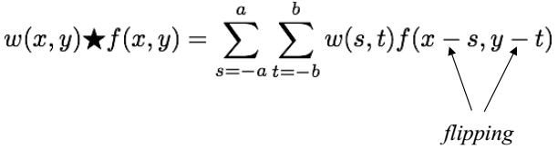
Convolution
Similar to correlation except that the mask is first flipped both horizontally and vertically (or rotated 180°).
Note: if w(i, j) is symmetric, that is w(i, j)=w(-i,-j), then convolution is equivalent to correlation!

Slide 50
Example
Correlation:
Convolution:

Slide 51
Vector Representation of Linear Filtering
Where the w’s are mask coefficients, the z’s are the value of the image gray levels corresponding to those coefficients
w₁
w₂
w₃
w₄
w₅
w₆
w₇
w₈
w₉

Slide 52
How do we choose the mask weights?
Typically, by sampling certain functions:
1st derivative
of Gaussian
2nd derivative
of Gaussian
Gaussian

Slide 53
Filters
We will mainly focus on two types of filters:
Smoothing (low-pass)
Sharpening (high-pass)

Slide 54
Smoothing Spatial Filters
Smoothing filters are used for blurring and for noise reduction.
Blurring is used in preprocessing steps, such as removal of small details from an image prior to object extraction, and bridging of small gaps in lines or curves
Noise reduction can be accomplished by blurring
Reduce “sharp” transitions in intensities
smoothing of false contours
There are 2 way of smoothing spatial filters
Smoothing Linear Filters
Order-Statistics Filters

Slide 55
Smoothing Linear Filters
Simply the average of the pixels contained in the neighborhood of the mask.
Sometimes called “averaging filters”
Two 3x3 Smoothing Linear Filters
1
1
1
1
2
1
1
1
1
2
4
2
1
1
1
1
2
1
Standard average
Weighted average

Slide 56
Smoothing Linear Filters
5x5 mask
The general implementation for filtering an MxN image with a weighted averaging filter of size mxn is given by the expression
1
1
1
1
1
1
1
1
1
1
1
1
1
1
1
1
1
1
1
1
1
1
1
1
1

Slide 57

Smoothing Linear Filters - example
Mask size determines the degree of smoothing (loss of detail).
original
3x3
5x5
9x9
15x15
35x35

Slide 58






Smoothing Linear Filters - example
Original Image
[3x3]
[5x5]
[7x7]
input image
smoothed image

Slide 59

Smoothing Linear Filters - example
Example: extract largest, brightest objects
15 x 15 averaging
image thresholding

Slide 60

Smoothing filters: Gaussian
The weights are Gaussian samples:
mask size is
a function of σ:

Slide 61


Smoothing filters: Gaussian filter
This kernel is an approximation of a Gaussian function:
σ = 1.4
Source: S. Seitz

Slide 62

Smoothing filters: Gaussian filter
This kernel is an approximation of a Gaussian function:
0 | 0 | 0 | 0 | 0 | 0 | 0 | 0 | 0 | 0
0 | 0 | 0 | 0 | 0 | 0 | 0 | 0 | 0 | 0
0 | 0 | 0 | 90 | 90 | 90 | 90 | 90 | 0 | 0
0 | 0 | 0 | 90 | 90 | 90 | 90 | 90 | 0 | 0
0 | 0 | 0 | 90 | 90 | 90 | 90 | 90 | 0 | 0
0 | 0 | 0 | 90 | 0 | 90 | 90 | 90 | 0 | 0
0 | 0 | 0 | 90 | 90 | 90 | 90 | 90 | 0 | 0
0 | 0 | 0 | 0 | 0 | 0 | 0 | 0 | 0 | 0
0 | 0 | 90 | 0 | 0 | 0 | 0 | 0 | 0 | 0
0 | 0 | 0 | 0 | 0 | 0 | 0 | 0 | 0 | 0
1 | 2 | 1
2 | 4 | 2
1 | 2 | 1
Source: S. Seitz

Slide 63


Gaussian filter
Weight contributions of neighboring pixels by nearness
0.003 0.013 0.022 0.013 0.003
0.013 0.059 0.097 0.059 0.013
0.022 0.097 0.159 0.097 0.022
0.013 0.059 0.097 0.059 0.013
0.003 0.013 0.022 0.013 0.003
5 x 5, σ = 1
Slide credit: Christopher Rasmussen
Notes:
e^0 = 1, e^-1 = .37, e^-2 = .14, etc.

Slide 64

Gaussian filters
What parameters matter here?
Size of kernel or mask
Note, Gaussian function has infinite support, but discrete filters use finite kernels
σ = 5 with 10 x 10 kernel
σ = 5 with 30 x 30 kernel

Slide 65




Gaussian filters
What parameters matter here?
Std Deviation of Gaussian: determines extent of smoothing
σ = 2 with 30 x 30 kernel
σ = 5 with 30 x 30 kernel
mask size is
a function of σ:

Slide 66






Smoothing with a Gaussian
Parameter σ is the “scale” / “width” / “spread” of the Gaussian kernel, and controls the amount of smoothing.
…

Slide 67


Smoothing filters: Gaussian (cont’d)
Original Image
Small σ
Large σ
Limited smoothing
Strong smoothing

Slide 68
Gaussian filters
Remove “high-frequency” components from the image (low-pass filter)
Images become more smooth
Convolution with self is another Gaussian
So can smooth with small-width kernel, repeat, and get same result as larger-width kernel would have
Convolving two times with Gaussian kernel of width σ is same as convolving once with kernel of width σ√2
Separable kernel
Factors into product of two 1D Gaussians
Source: K. Grauman
Notes:
Linear vs. quadratic in mask size

Slide 69
Separability of the Gaussian filter
Source: D. Lowe

Slide 70
Smoothing filters: Gaussian (cont’d)
σ controls the amount of smoothing
As σ increases, more samples must be obtained to represent the Gaussian function accurately.
σ = 3

Slide 71



Averaging vs Gaussian Smoothing
Averaging
Gaussian

Slide 72

Smoothing with a Gaussian

Slide 73
Smoothing with a Box filter

Slide 74
Note: Smoothing Filters (low-pass)
The elements of the mask must be positive.
Sum of mask elements is 1 (after normalization).

Slide 75
Nonlinear spatial filtering
Nonlinear spatial filters also operate on neighborhoods, and the mechanics of sliding a mask past an image are the same as was just outlined.
The filtering operation is based conditionally on the values of the pixels in the neighborhood under consideration

Slide 76
Order-Statistics Filters
nonlinear spatial filters
response is based on ordering (ranking) the pixels contained in the image area encompassed by the filter, and then replacing the value of the center pixel with the value determined by the ranking result.
Best-known “median filter”
Good noise-reduction capabilities with less smoothing (e.g. impulse noise, or salt-and-pepper noise )

Slide 77
Non-linear smoothing
Median filter
Corp region of neighborhood
Sort the values of the pixel in our region
In the mxn mask the median is (mxn div 2)+1
10
15
20
20
100
20
20
20
25
10, 15, 20, 20, 20, 20, 20, 25, 100
5th

Slide 78
Non-linear smoothing
Median filter
It is widely used as it is very effective at removing noise while preserving edges.
It is particularly effective at removing ‘salt and pepper’ type noise.
10
15
20
20
100
20
20
20
25
10, 15, 20, 20, 20, 20, 20, 25, 100
5th

Slide 79
Smoothing filters: Box filter
This kernel is an approximation of a Gaussian function:
0 | 0 | 0 | 0 | 0 | 0 | 0 | 0 | 0 | 0
0 | 0 | 0 | 0 | 0 | 0 | 0 | 0 | 0 | 0
0 | 0 | 0 | 90 | 90 | 90 | 90 | 90 | 0 | 0
0 | 0 | 0 | 90 | 90 | 90 | 90 | 90 | 0 | 0
0 | 0 | 0 | 90 | 90 | 90 | 90 | 90 | 0 | 0
0 | 0 | 0 | 90 | 0 | 90 | 90 | 90 | 0 | 0
0 | 0 | 0 | 90 | 90 | 90 | 90 | 90 | 0 | 0
0 | 0 | 0 | 0 | 0 | 0 | 0 | 0 | 0 | 0
0 | 0 | 90 | 0 | 0 | 0 | 0 | 0 | 0 | 0
0 | 0 | 0 | 0 | 0 | 0 | 0 | 0 | 0 | 0
- | - | - | - | - | - | - | - | - | -
- | 0 | 10 | 20 | 30 | 30 | 30 | 20 | 10 | -
- | 0 | 20 | 40 | 60 | 60 | 60 | 40 | 20 | -
- | 0 | 30 | 60 | 90 | 90 | 90 | 60 | 30 | -
- | 0 | 30 | 50 | 80 | 80 | 90 | 60 | 30 | -
- | 0 | 30 | 50 | 80 | 80 | 90 | 60 | 30 | -
- | 0 | 20 | 30 | 50 | 50 | 60 | 40 | 20 | -
- | 10 | 20 | 30 | 30 | 30 | 30 | 20 | 10 | -
- | 10 | 10 | 10 | 0 | 0 | 0 | 0 | 0 | -
- | - | - | - | - | - | - | - | - | -
1 | 1 | 1
1 | 1 | 1
1 | 1 | 1
Source: S. Seitz

Slide 80
Smoothing filters: Gaussian filter
This kernel is an approximation of a Gaussian function:
0 | 0 | 0 | 0 | 0 | 0 | 0 | 0 | 0 | 0
0 | 0 | 0 | 0 | 0 | 0 | 0 | 0 | 0 | 0
0 | 0 | 0 | 90 | 90 | 90 | 90 | 90 | 0 | 0
0 | 0 | 0 | 90 | 90 | 90 | 90 | 90 | 0 | 0
0 | 0 | 0 | 90 | 90 | 90 | 90 | 90 | 0 | 0
0 | 0 | 0 | 90 | 0 | 90 | 90 | 90 | 0 | 0
0 | 0 | 0 | 90 | 90 | 90 | 90 | 90 | 0 | 0
0 | 0 | 0 | 0 | 0 | 0 | 0 | 0 | 0 | 0
0 | 0 | 90 | 0 | 0 | 0 | 0 | 0 | 0 | 0
0 | 0 | 0 | 0 | 0 | 0 | 0 | 0 | 0 | 0
- | - | - | - | - | - | - | - | - | -
- | 0 | 6 | 17 | 23 | 23 | 23 | 17 | 6 | -
- | 0 | 17 | 51 | 68 | 68 | 68 | 51 | 17 | -
- | 0 | 23 | 68 | 90 | 90 | 90 | 68 | 23 | -
- | 0 | 23 | 62 | 79 | 84 | 90 | 68 | 23 | -
- | 0 | 23 | 56 | 68 | 79 | 90 | 68 | 23 | -
- | 0 | 17 | 45 | 56 | 62 | 68 | 51 | 17 | -
- | 6 | 17 | 23 | 23 | 23 | 23 | 17 | 6 | -
- | 11 | 23 | 11 | 0 | 0 | 0 | 0 | 0 | -
- | - | - | - | - | - | - | - | - | -
1 | 2 | 1
2 | 4 | 2
1 | 2 | 1
Source: S. Seitz

Slide 81
Smoothing filters: Median filter
0 | 0 | 0 | 0 | 0 | 0 | 0 | 0 | 0 | 0
0 | 0 | 0 | 0 | 0 | 0 | 0 | 0 | 0 | 0
0 | 0 | 0 | 90 | 90 | 90 | 90 | 90 | 0 | 0
0 | 0 | 0 | 90 | 90 | 90 | 90 | 90 | 0 | 0
0 | 0 | 0 | 90 | 90 | 90 | 90 | 90 | 0 | 0
0 | 0 | 0 | 90 | 0 | 90 | 90 | 90 | 0 | 0
0 | 0 | 0 | 90 | 90 | 90 | 90 | 90 | 0 | 0
0 | 0 | 0 | 0 | 0 | 0 | 0 | 0 | 0 | 0
0 | 0 | 90 | 0 | 0 | 0 | 0 | 0 | 0 | 0
0 | 0 | 0 | 0 | 0 | 0 | 0 | 0 | 0 | 0
- | - | - | - | - | - | - | - | - | -
- | 0 | 0 | 0 | 0 | 0 | 0 | 0 | 0 | -
- | 0 | 0 | 0 | 90 | 90 | 90 | 0 | 0 | -
- | 0 | 0 | 90 | 90 | 90 | 90 | 90 | 0 | -
- | 0 | 0 | 90 | 90 | 90 | 90 | 90 | 0 | -
- | 0 | 0 | 90 | 90 | 90 | 90 | 90 | 0 | -
- | 0 | 0 | 0 | 90 | 90 | 90 | 0 | 0 | -
- | 0 | 0 | 0 | 0 | 0 | 0 | 0 | 0 | -
- | 0 | 0 | 0 | 0 | 0 | 0 | 0 | 0 | -
- | - | - | - | - | - | - | - | - | -
Source: S. Seitz

Slide 82
Non-linear smoothing- Median filtering
nonlinear
median{ x(m) + y(m) } ≠ median{x(m)} + median{y(m)}
Odd window size is commonly used
3x3, 5x5, 7x7
5-pixel “+”-shaped window
for even-sized windows take the average of two middle values as output
resilient to statistical outliers
incurs less blurring
simple to implement

Slide 83

Median filter example
Very effective for removing “salt and pepper” noise (i.e., random occurrences of black and white pixels).
median
filtering
averaging

Slide 84
Median filter example

Slide 85


Result of median filter
Noise from Glass effect
Remove noise by median filter

Slide 86




Order statistics filters
Other order statistics:
Min filter, max filter, x-percentile …
original

Slide 87
Sharpening Spatial Filters
The principal objective
highlight fine detail in an image or to enhance detail that has been blurred
either in error or as an natural effect of a particular method of image acquisition.
Normally, sharpening is done by highlighting the transitions in intensity
Methods
Unsharp masking
High Boost filtering
Laplacian (2nd order derivative)
Gradient (1st order derivative)

Slide 88

Unsharp masking and High boost Filtering
Blur the original image f(x,y)
Subtract the blurred image from the original (result called the mask):
Add the mask to the original:
k ≥ 0
• k = 1 => unsharp masking • k > 1 => highboost filtering

Slide 89





Example
Original
Blurred
Mask (scaled)
Unsharp Mask
High boost

Slide 90
Foundation
Definition of 1st / 2nd derivative
A basic definition of the first-order derivative of a one-dimensional function f(x) is
We define a second-order derivative as the difference
(h=1)

Slide 91
Foundation
We are interested in the behavior of 1st and 2nd order derivatives in areas of
Constant gray level(flat segments),
At the onset and end of discontinuities (step and ramp discontinuities),
Along gray-level ramps.
These types of discontinuities can be noise points, lines, and edges.

Slide 92
Definition for a first derivative
Must be zero in flat segments
Must be nonzero at the onset of a gray-level step or ramp; and
Must be nonzero along ramps.

Slide 93
Definition for a second derivative
Must be zero in flat areas;
Must be nonzero at the onset and end of a gray-level step or ramp;
Must be zero along ramps of constant slope

Slide 94

Gray-level profile
0
0
0
1
2
3
2
0
0
2
2
6
3
3
2
2
3
3
0
0
0
0
0
0
7
7
6
5
5
3
7
6
5
4
3
2
1
0

Slide 95
Derivative of image profile
0 0 0 1 2 3 2 0 0 2 2 6 3 3 2 2 3 3 0 0 0 0 0 0 7 7 6 5 5 3
first
0
0 1 1 1-1-2 0 2 0 4-3 0-1 0 1 0-3 0 0 0 0 0 7 0-1-1 0-2
second
0 1 0 0-2-1 2 2-2 4-7 3-1 1 1-1-3 3 0 0 0 0 7-7-1 0 1-2

Slide 96

Foundation

Slide 97
Analyze
Both derivative is zero for constant areas
The 1st-order derivative is nonzero along the entire ramp, while the 2nd-order derivative is nonzero only at the onset and end of the ramp.
The response at and around the point is much stronger for the 2nd- than for the 1st-order derivative
Edges in digital images often are ramp like
1st derivative make thick edge and 2nd derivative make a thin double edge
2nd derivative is better than 1st to enhance fine detail

Slide 98
The Laplacian (2nd order derivative)
Shown by Rosenfeld and Kak[1982] that the simplest isotropic derivative operator is the Laplacian is defined as
Discrete form of derivative
f(x-1,y)
f(x,y)
f(x+1,y)
f(x,y-1)
f(x,y)
f(x,y+1)

Slide 99


The Laplacian - mask
The digital implementation of the 2-D Laplacian is obtained by summing 2 components
Edges can be found
by detect the zero-crossings

Slide 100
The Laplacian - mask
Isotropic mask with 45° rotation increment
Isotropic mask with 90° rotation increment
0
1
0
1
1
1
1
-4
1
1
-8
1
0
1
0
1
1
1
1
0
1
0
-4
0
1
0
1

Slide 101
Laplacian mask
variants
0
-1
0
-1
-1
-1
-1
4
-1
-1
8
-1
0
-1
0
-1
-1
-1
-1
0
-1
0
4
0
-1
0
-1

Slide 102
Sharpening using Laplacian
If the center coefficient is negative
If the center coefficient is positive
Where f(x,y) is the original image
is Laplacian filtered image
g(x,y) is the sharpen image

Slide 103



Laplacian - Example
Laplacian without scaling
Original
0
-1
0
-1
4
-1
0
-1
0
with scaling

Slide 104


Sharpening: Laplacian - example
Original
Sharpened with Laplacian

Slide 105
Sharpening: Laplacian
Using Laplacian filter to original image
And then add the Laplacian result to the original image
Simplification
We can apply two step in one mask
0
-1
0
-1
-1
-1
-1
5
-1
-1
9
-1
0
-1
0
-1
-1
-1

Slide 106
The Gradient (1st order derivative)
First Derivatives in image processing are implemented using the magnitude of the gradient.
The gradient of function f(x,y) is
The magnitude of this vector
Gradient is a linear but not rotation invariant (isotropic)
Magnitude is not linear, but is isotropic
Approximation
Isotropic property lost (in general)

Slide 107
The Gradient
The simplest approximations to a first-order derivative are
Robert’s cross operator
G_{y}
-1
1
This mask is simple, and no isotropic. Its result only horizontal and vertical.
1
G_{x}
-1
-1
0
y
0
1
z₁
z₂
z₃
G_{x}
x
z₄
z₅
z₆
G_{x} = (z₉-z₅) and G_{y} = (z₈-z₆)
0
-1
z₇
z₈
z₉
1
0
G_{y}

Slide 108
Sobel’s Method
Mask of even size are awkward to apply.
The smallest filter mask should be 3x3.
-1
-2
-1
-1
0
1
0
0
0
-2
0
2
1
2
1
-1
0
1

Slide 109




Example: Gradient Magnitude Image
Gradient Magnitude
(isotropic)

Slide 110



Example: Laplacian vs Gradient
Sobel
Laplacian

Slide 111


Other operators
Prewitt
Scharr
y
x

Slide 112
Combining Spatial Enhancement Methods
An example
Laplacian to highlight fine detail
Gradient to enhance prominent edges
Smoothed version of the gradient image used to mask the Laplacian image
Increase the dynamic range of the gray levels by using a gray-level transformation

Slide 113



Slide 114



Slide 115

Apply 3x3 Median filter
5 | 0 | 5 | 15 | 7 | 7
8 | 7 | 7 | 6 | 7 | 9
4 | 0 | 5 | 6 | 7 | 8
5 | 4 | 5 | 15 | 7 | 10
5 | 4 | 0 | 5 | 8 | 10
5 | 4 | 5 | 6 | 15 | 8

Slide 116
Ref.
Digital Image Processing, 3rd ed, Gonzalez & Woods
www.cs.su.ac.th/~kanawong/courses/517483/ppt/Spatial Filtering.ppt
www.cse.unr.edu\~bebis\CS474\Lectures\SpatialFiltering.ppt
www.acfr.usyd.edu.au\courses\amme4710\Lectures\AMME4710-Chap3-SpatialFiltering.pdf
www.csie.nuk.edu.tw\~tkyin\2016Spring\ImageProcessing2016Spring\Slides\3\chap3.ppt

